Slide 1
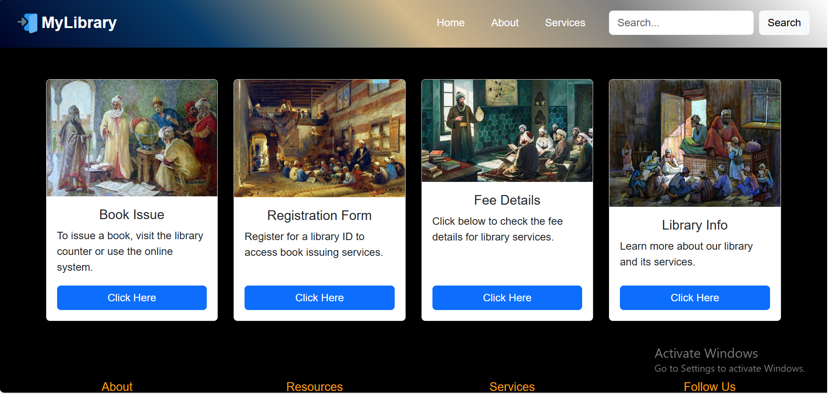
Ali Jiwani Digital library
By Ali Muhammad
&
Mubina Ali

Slide 2
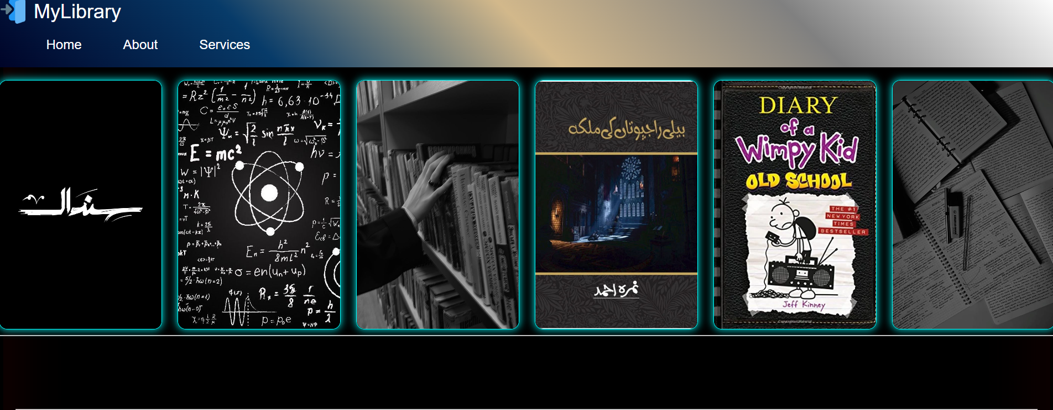
Features
1. Bookshelves & Section Guide
Our website provides a detailed guide to bookshelf numbers and sections, helping visitors quickly locate books. Users can explore categorized book listings, check availability, and navigate the library more efficiently.

Slide 3

2. Online Registration Form
New members can easily register through our online registration form. The form allows users to enter their details, choose a membership type, and gain access to the library's resources. This feature ensures a seamless sign-up process for all visitors.

Slide 4

3. Fee Collection System
Our website includes a secure fee collection system, allowing users to pay membership fees, late return charges, or other dues online. This feature provides convenience by eliminating the need for in-person payments and ensuring timely fee submissions.

Slide 5
Meet Our Library Team
Sir Yasir
Usman

Slide 6
Muneeba
Hina
Siyan
Karim
Muneeb

